Slide 1

British Airways Review Analysis

Slide 2
Section 1: Key Metrics
Total Reviews Analyzed(3899 )
% Neutral(Neutral: 44.74%)
% Positive (34.08%)
% Negative(21.18%)

Slide 3
Section 2: Visuals

Slide 4


Slide 5
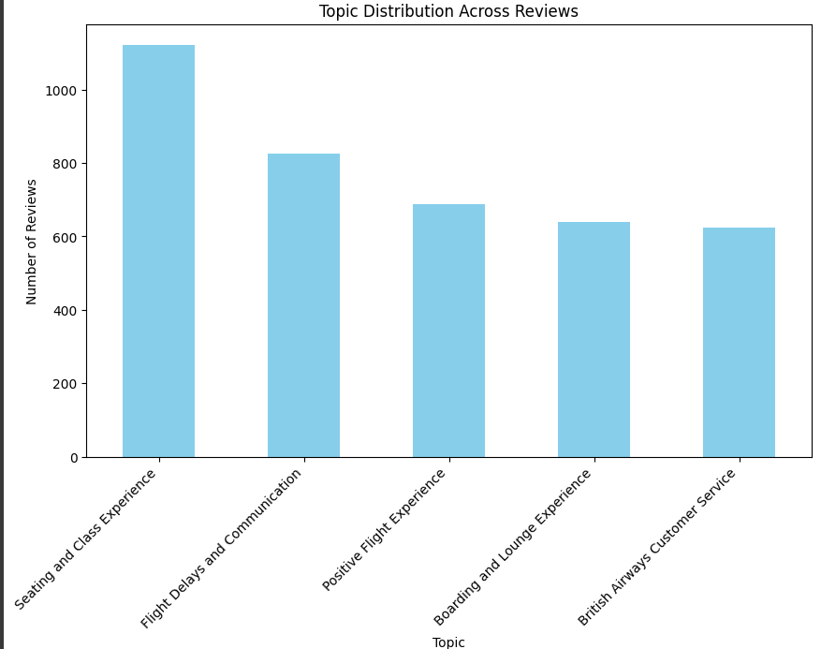

Slide 6
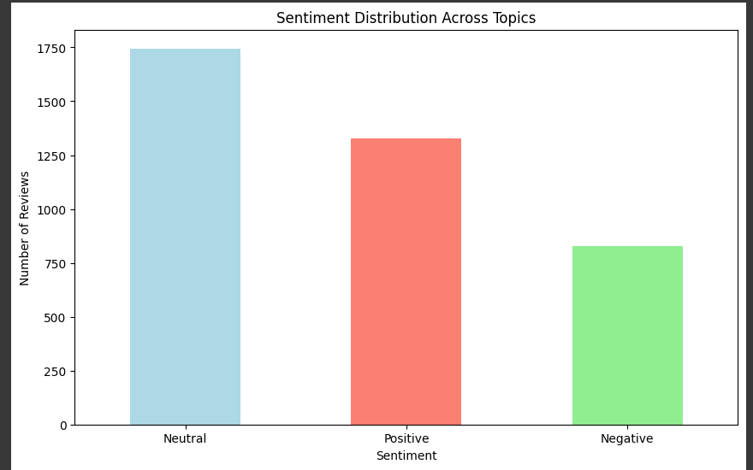

Slide 7
Main Insights :
Most of the reviews are Neutral
→ About 45% of people gave reviews that were neither very good nor very bad.
Many people gave Positive feedback
→ Around 34% of reviews are positive, which means people were happy or satisfied.
Some reviews are Negative
→ About 21% of the reviews show that people were not satisfied or had complaints.

